Slide 1
Algorithmic Trading
Whitney, Marjorie, Yonathan, Emmanuel

Slide 2
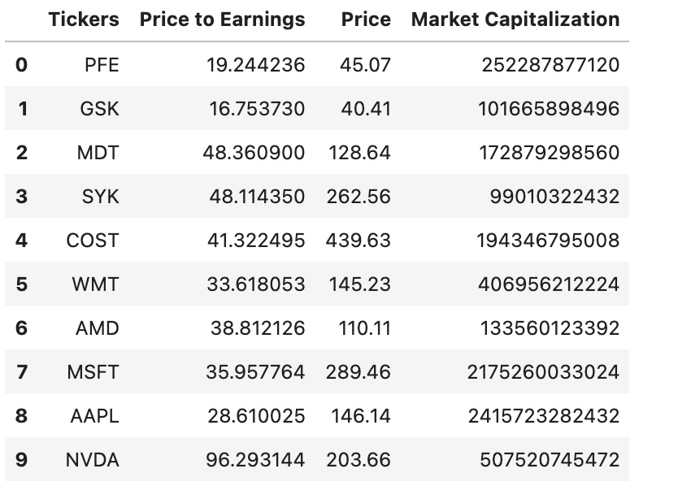
Motivation & Summary
Goal of the Project
The objective of our project was to use a Deep Learning model to predict future stock values for our trading algorithm. The project uses trading signals and deep/machine learning techniques based on a set of rules using technical indicators.
We utilized Yahoo Finance API to gather information on 10 selected companies including:
MedTronic, Stryker, Costco, Walmart, Pfizer, Glaxokline, Apple, AMD, Microsoft
, NVDA
The time period is from 01/01/2007 to present.
Used historical quote prices to predict future prices.
We used 80% of this data as our training set and 20% as test set.

Slide 3
Model Summary
Model we used comprised of both data and procedures on how to make predictions
Utilized Yahoo Finance API to extract financial data including historical and present data
Exploratory data analysis on stock pricing data including closing prices, forecast data, using Python to load the data in the dataframe
Retrieved Moving averages and Formulating trading strategy with Python
Visualizing the performance of the strategy using HVPLOT and Plotly
Forecasting Returns using Rolling averages for this Model.
Forecasting the Settle Price using Rolling averages.

Slide 4
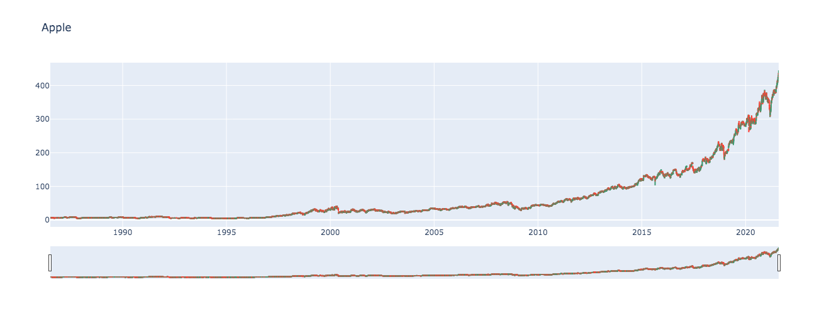
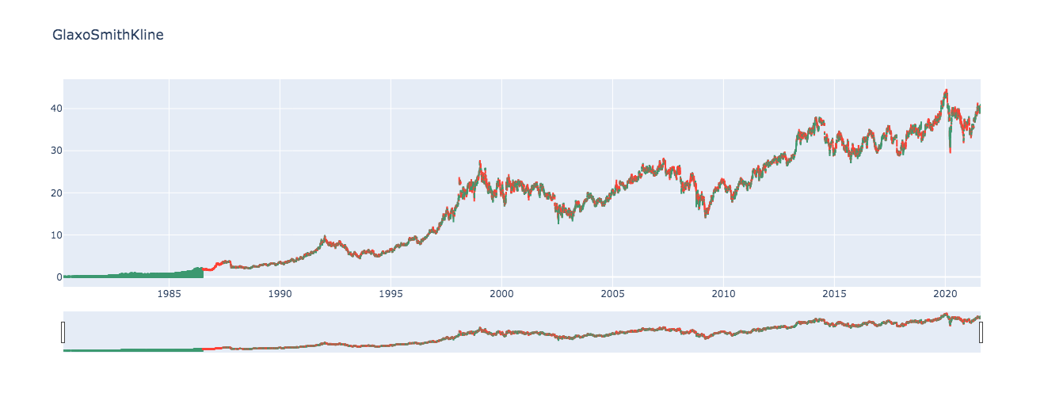
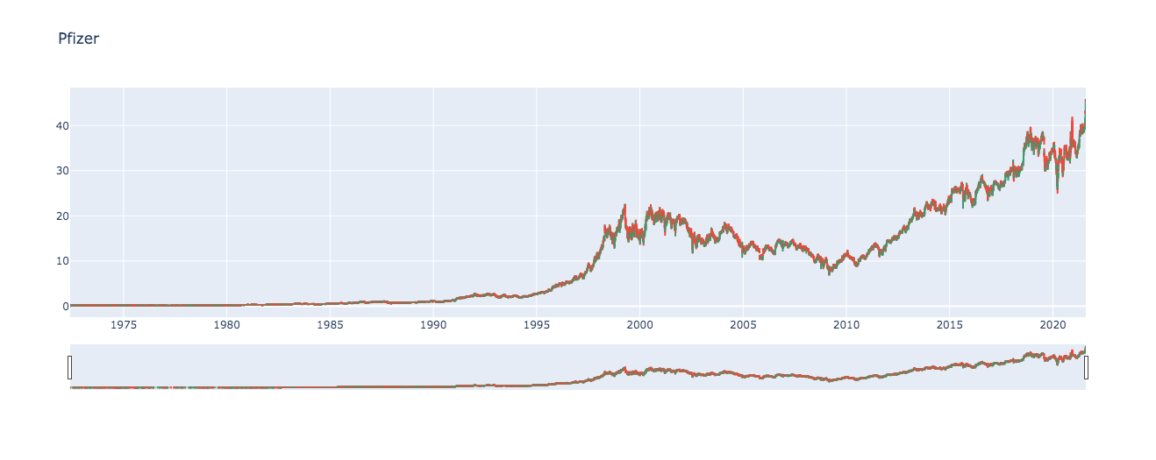
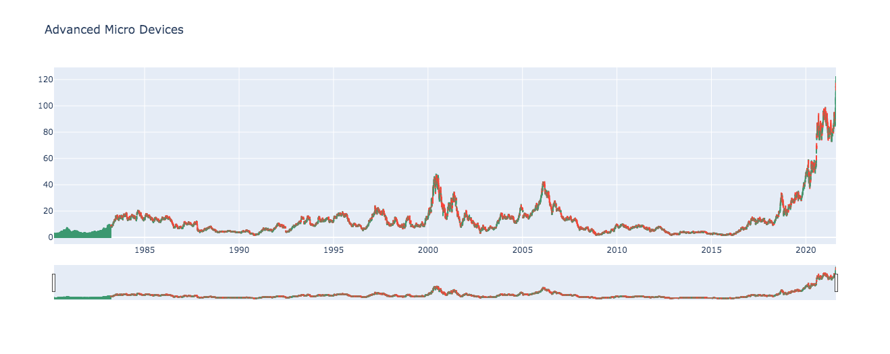
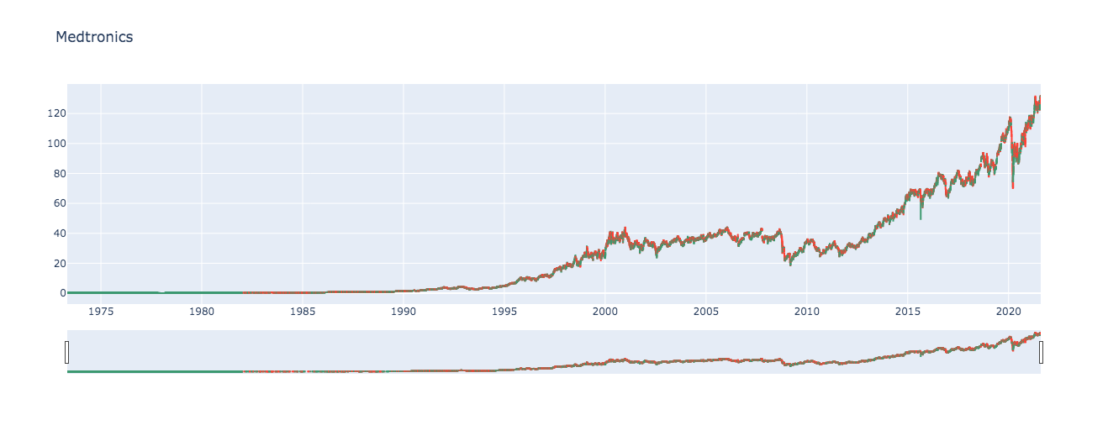
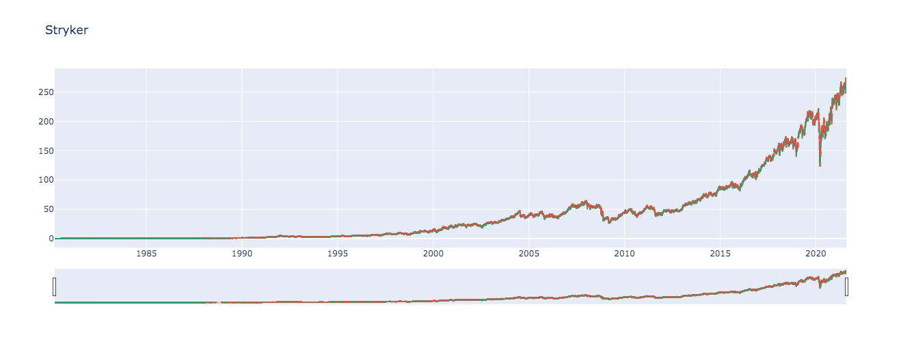

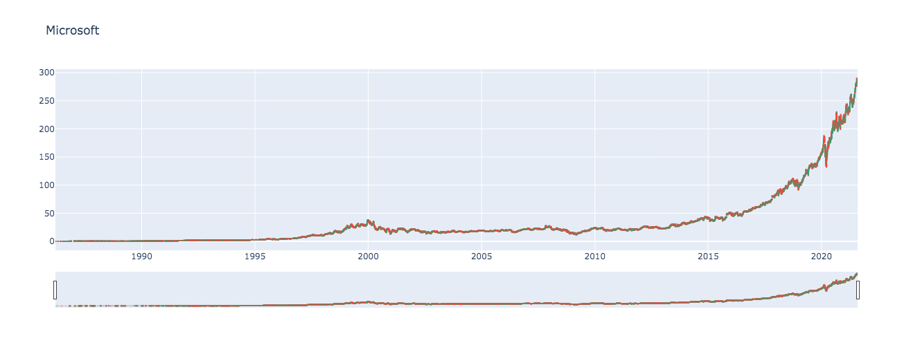
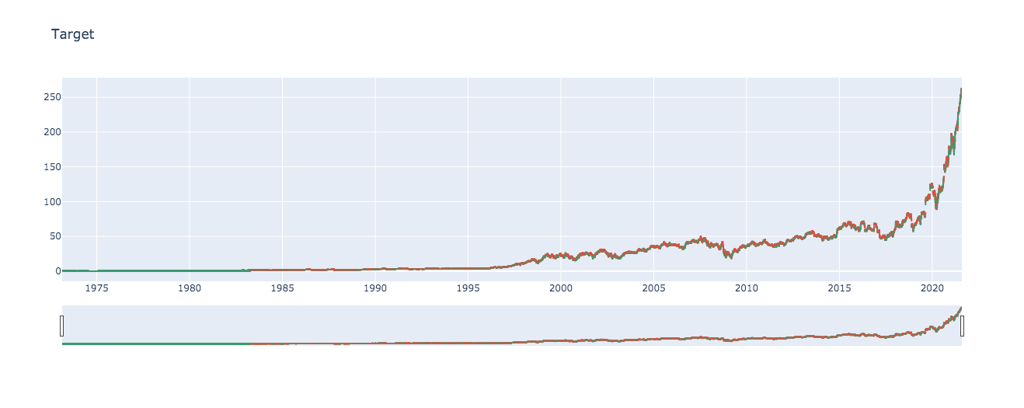
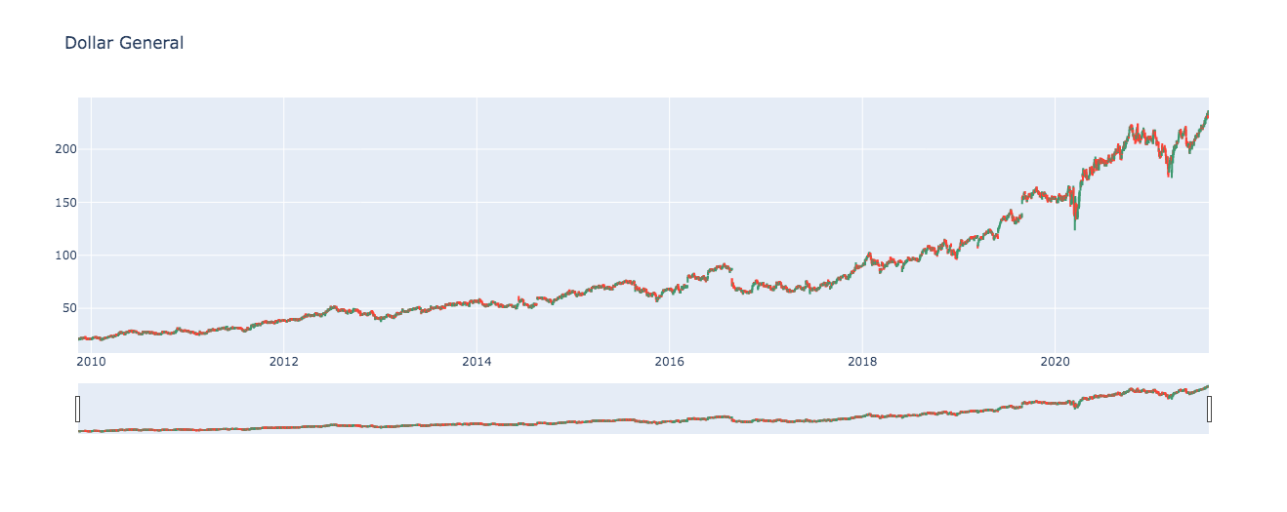
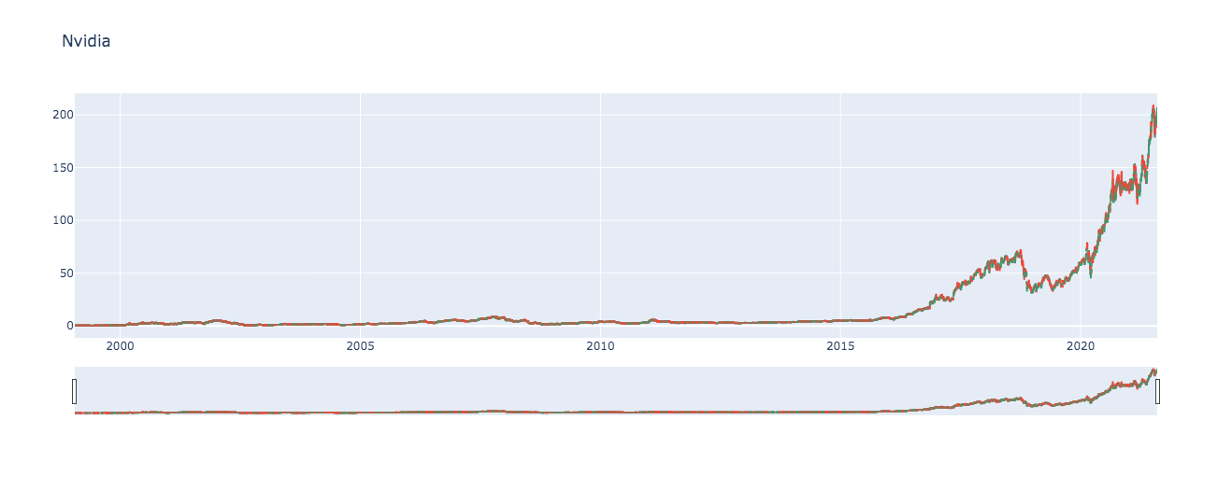
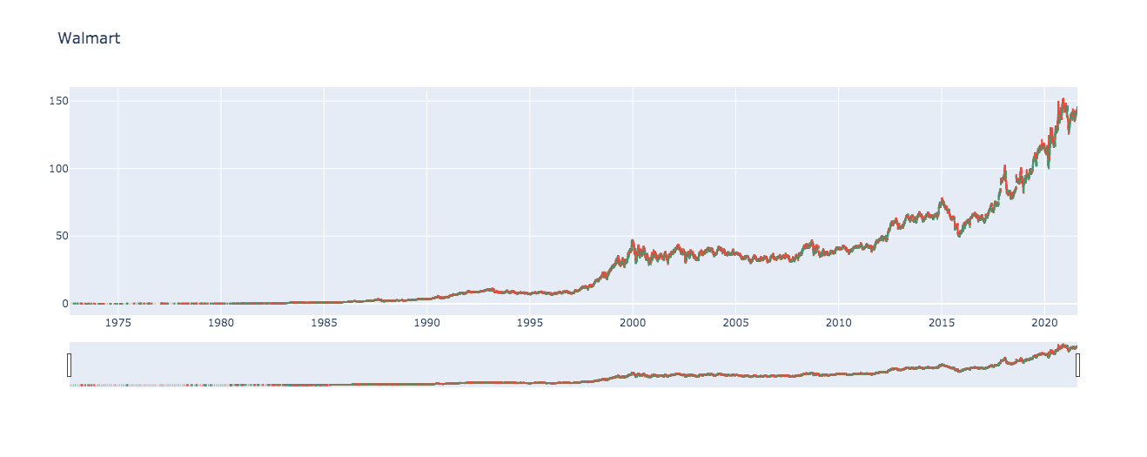
Historical Charts

Slide 5
Data Cleanup & Model Training
We back tested by using a machine-learning strategy with our own methods on daily or intraday price data in two different scenarios. One for training the machine learning model and one for backtesting the strategy
ML Long/Short Prediction Strategy:
Model Training - Closing prices
Strategy backtesting - Daily Price and Intraday price data
We encountered issues using Alpaca API historical data didn’t include timeframe we were looking at. The NewsAPI also had character limitations.

Slide 6
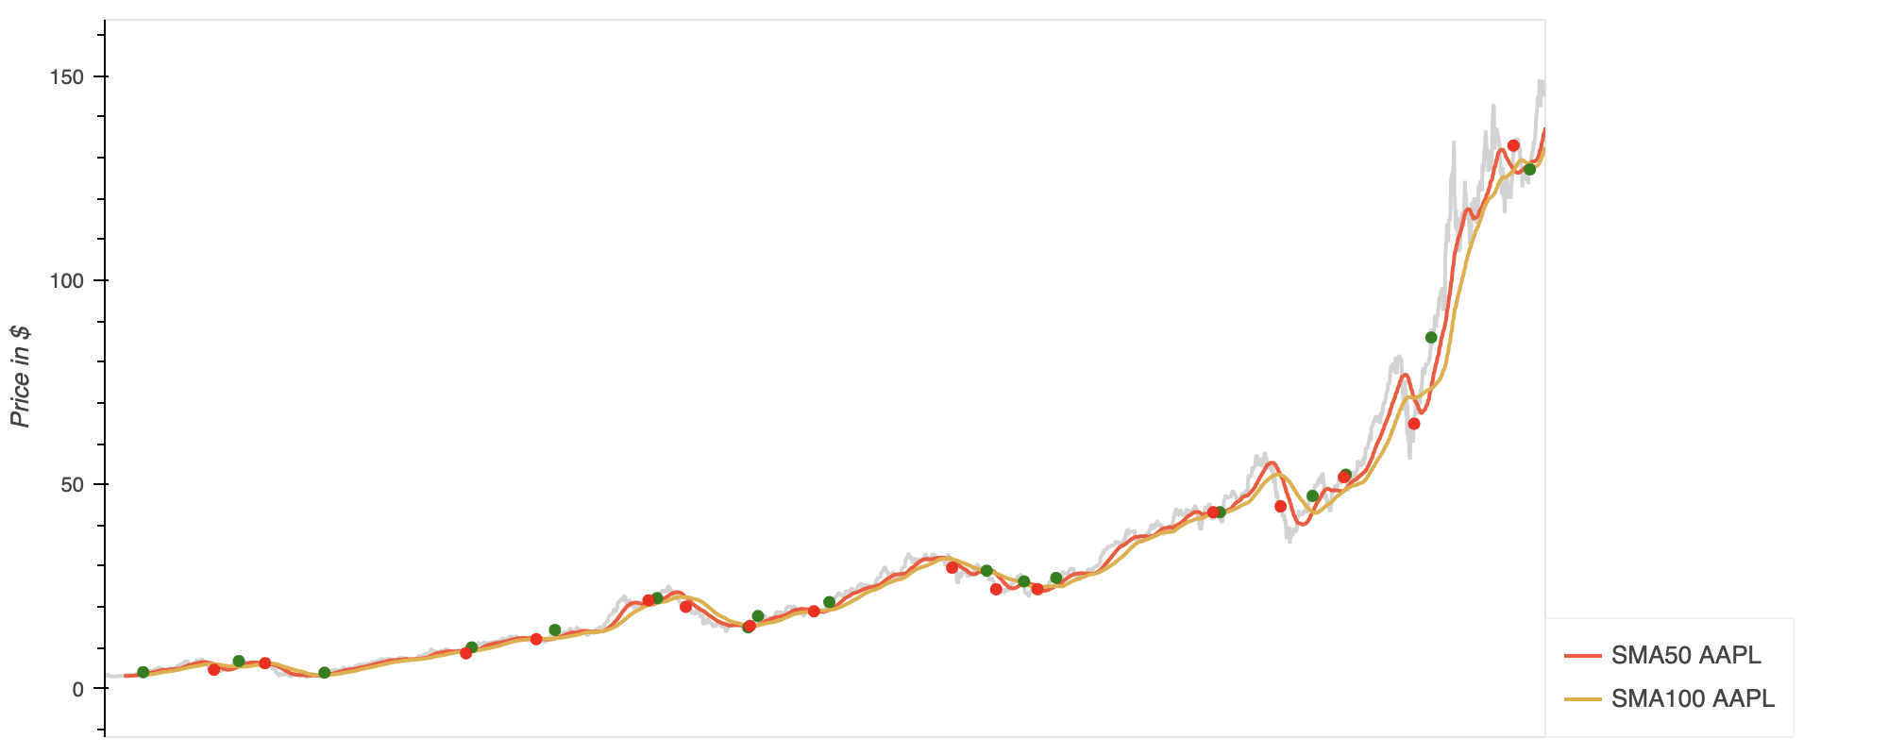
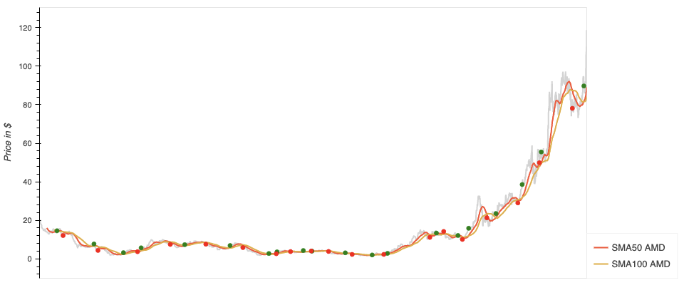
Visualization of the entry and exit points

Slide 7
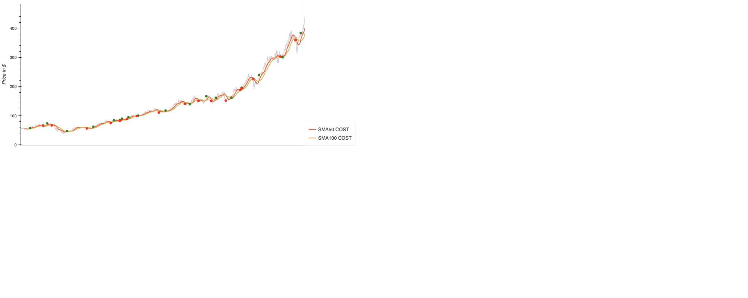
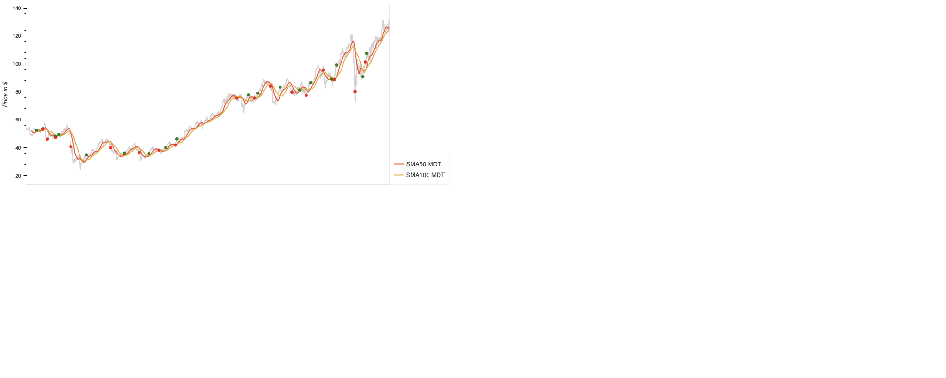
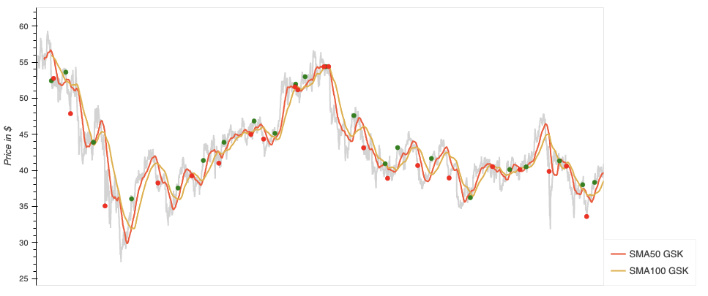
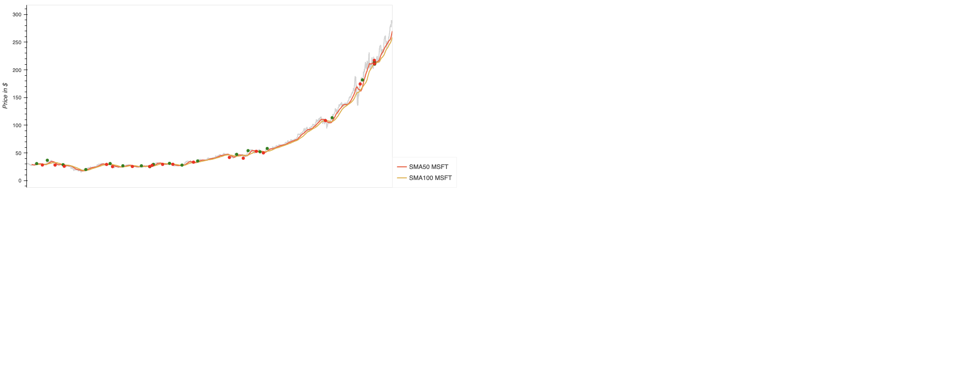
Visualizations of Entry and Exit continued

Slide 8
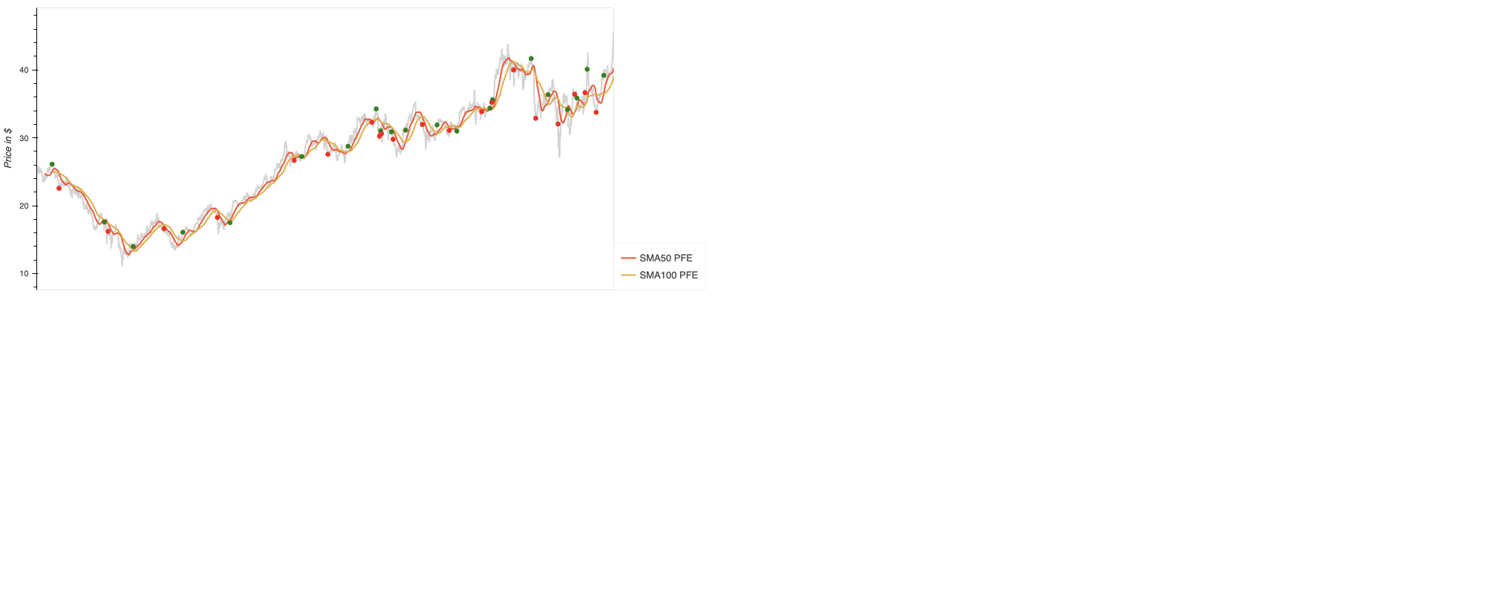
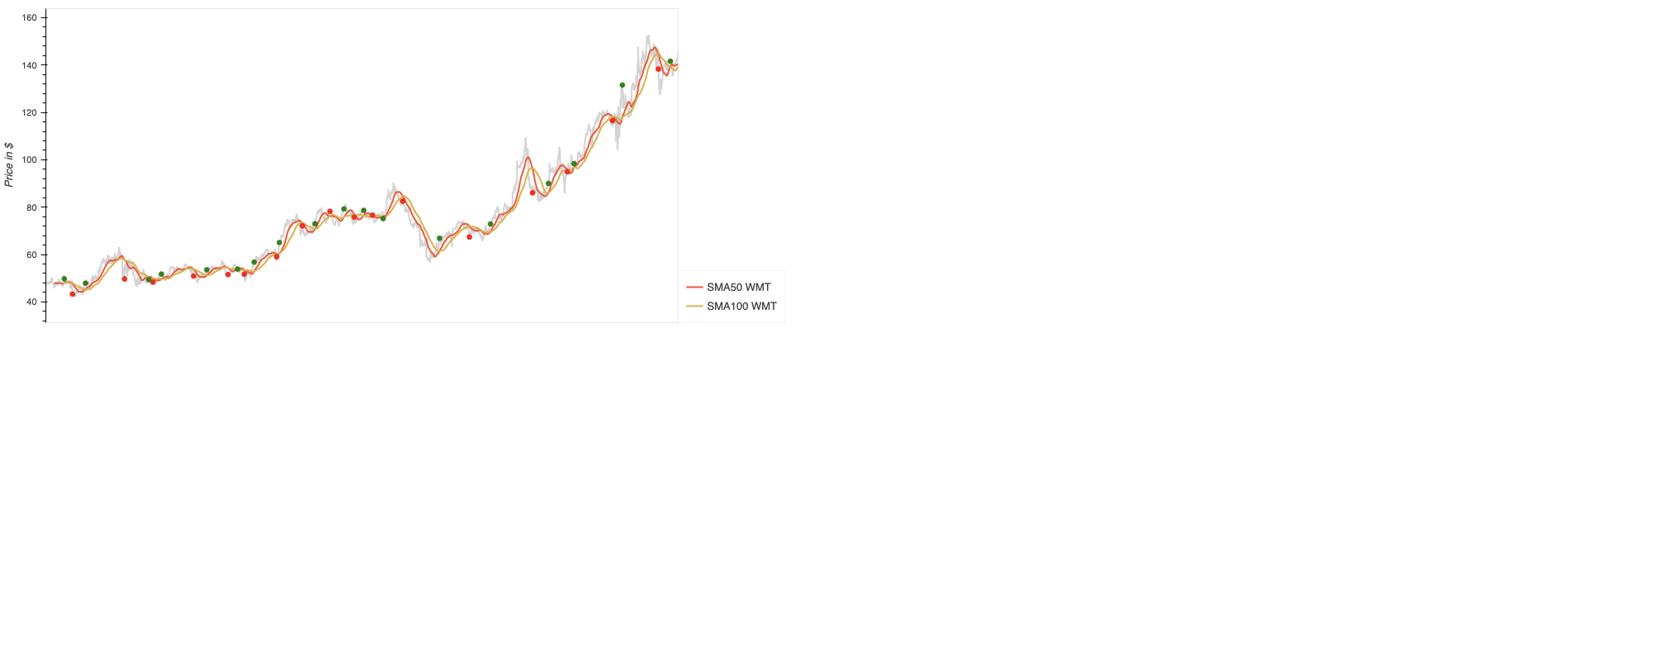
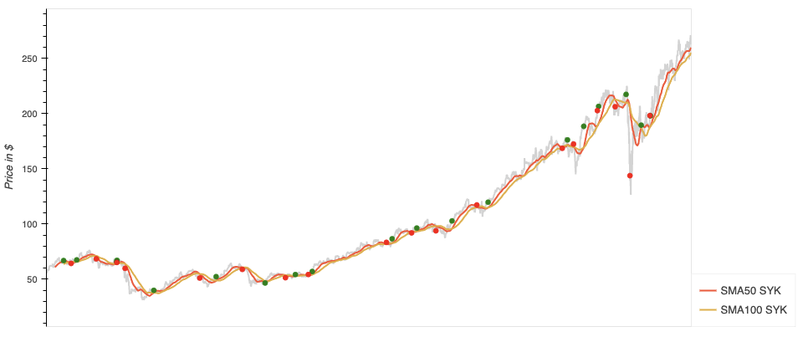
Visualizations of Entry and Exit continued

Slide 9
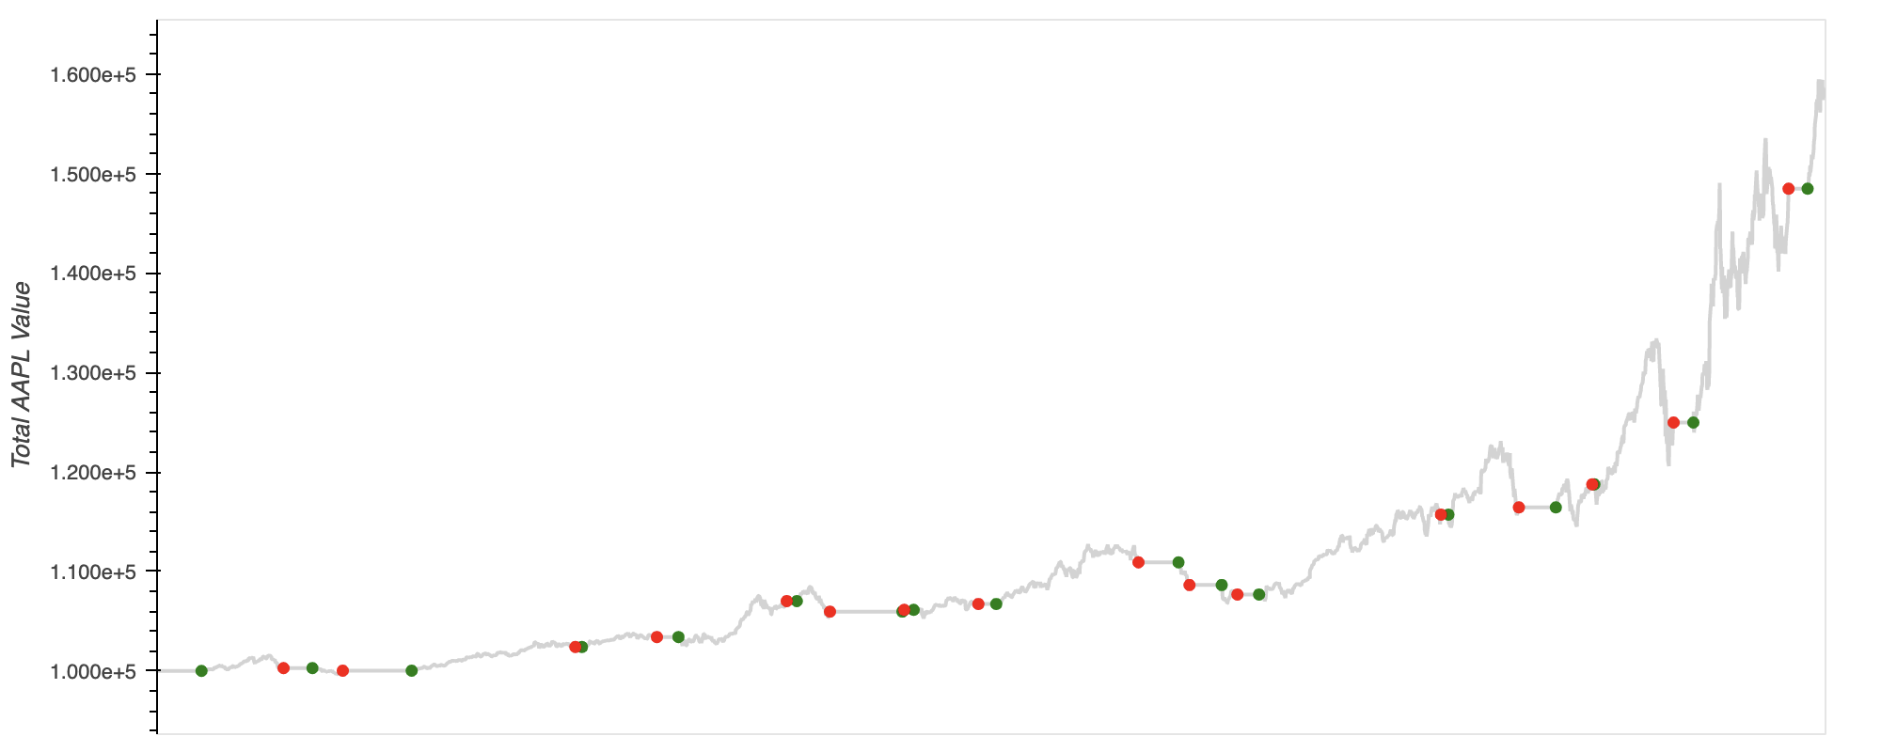
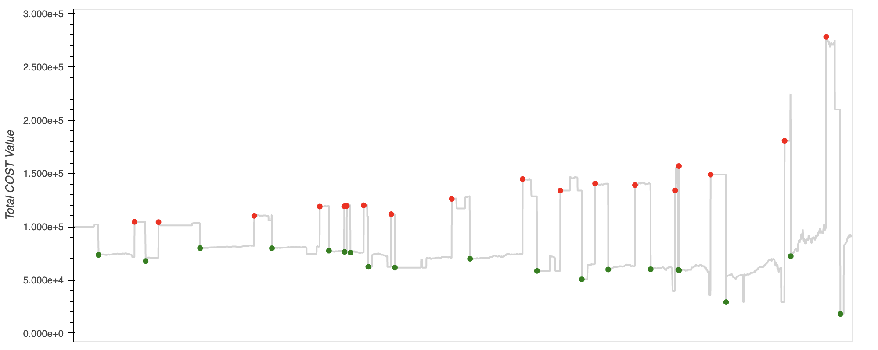
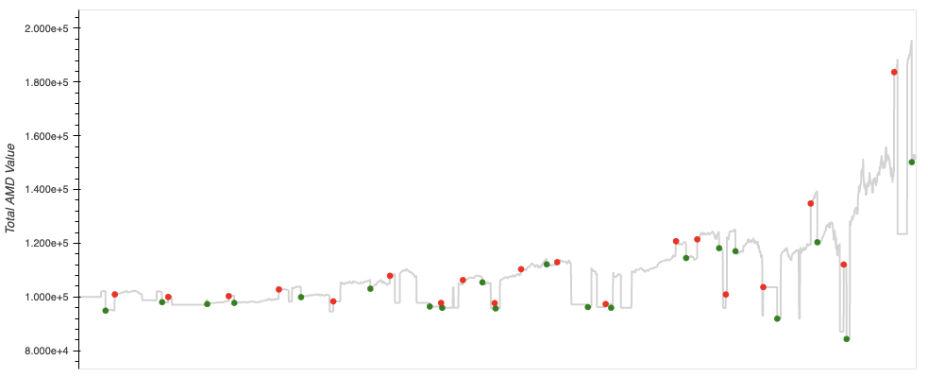
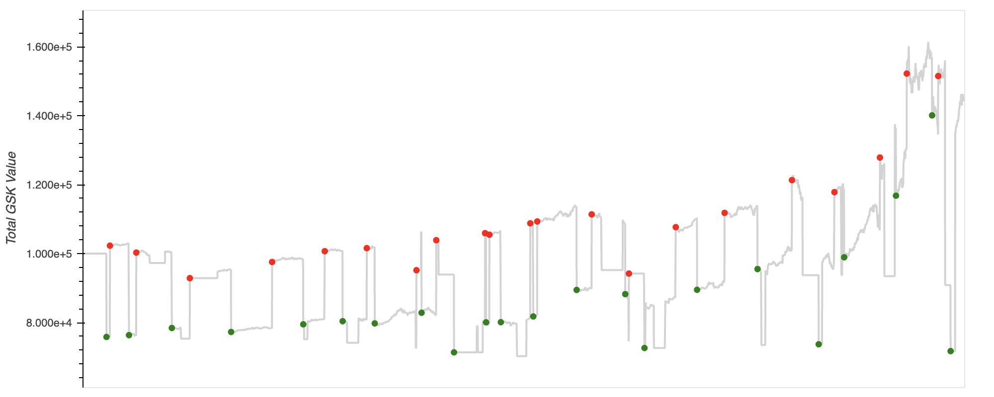
Strategy Vs. Backtest results

Slide 10
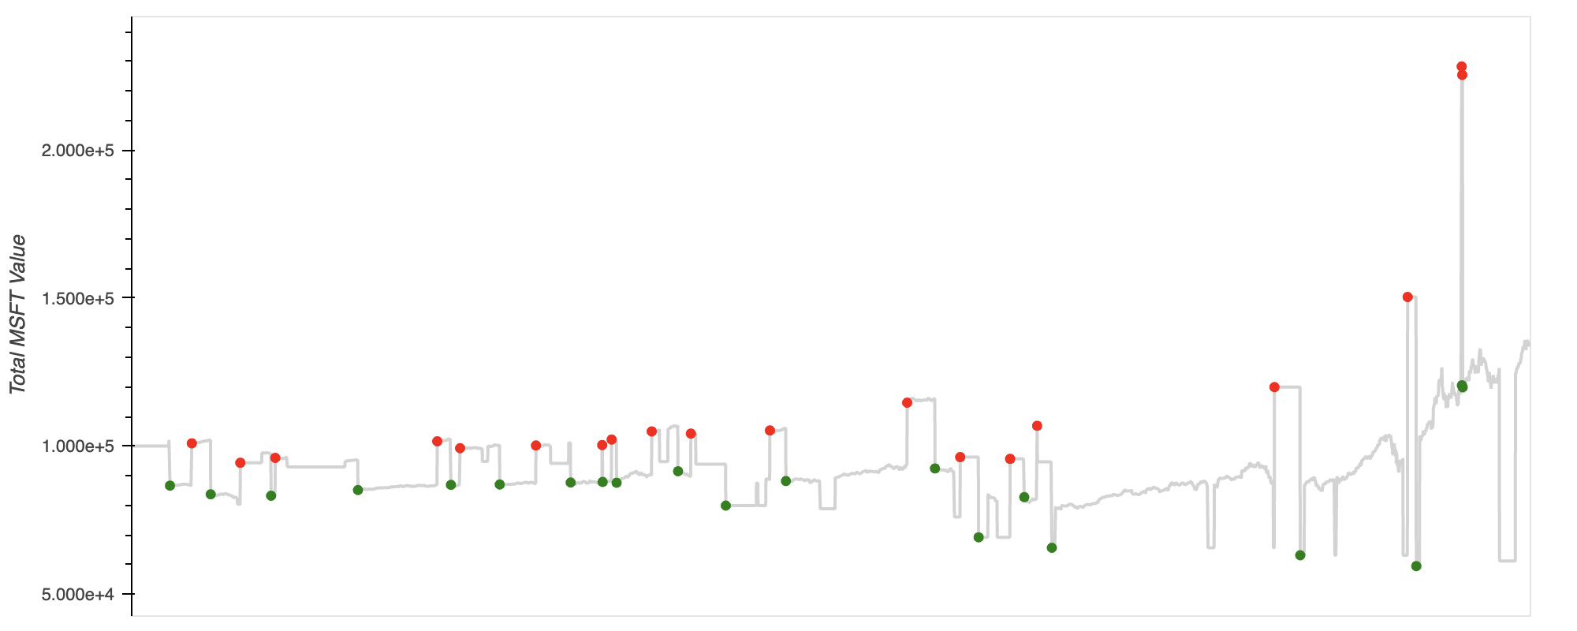
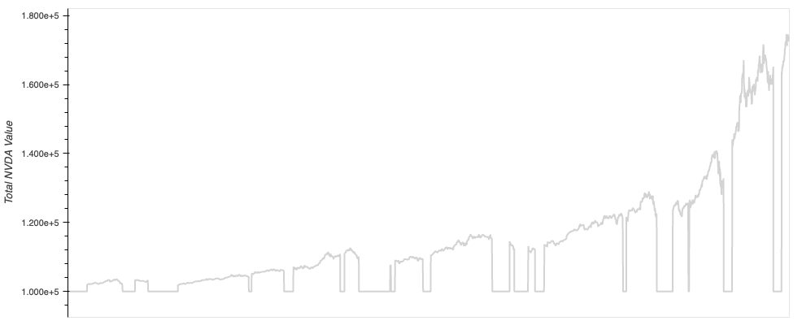
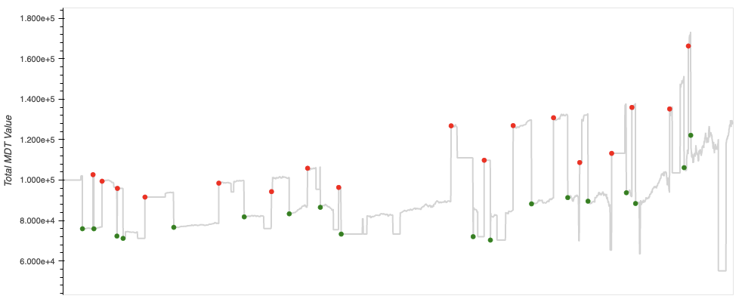
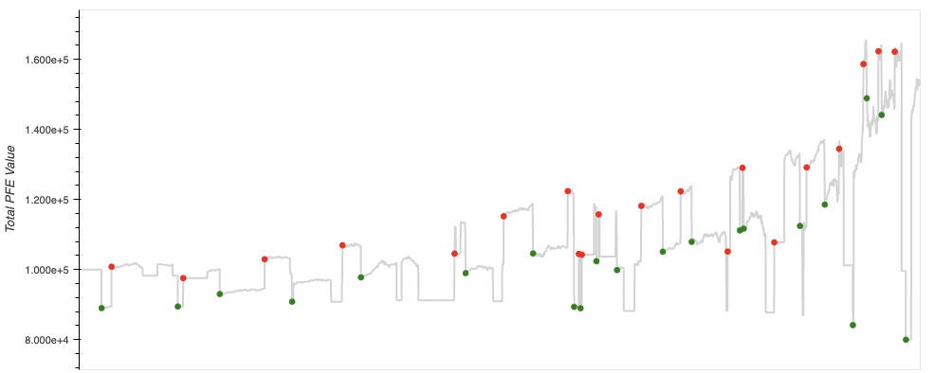
Strategy Vs. Backtest results

Slide 11
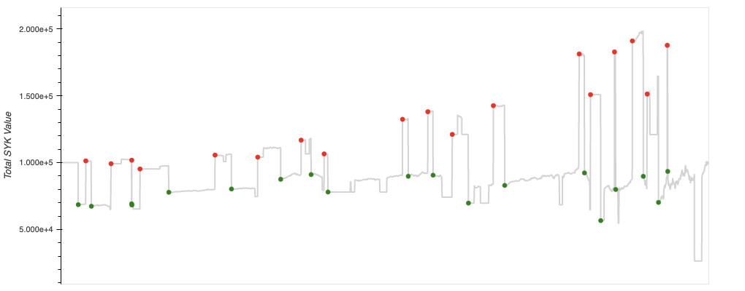
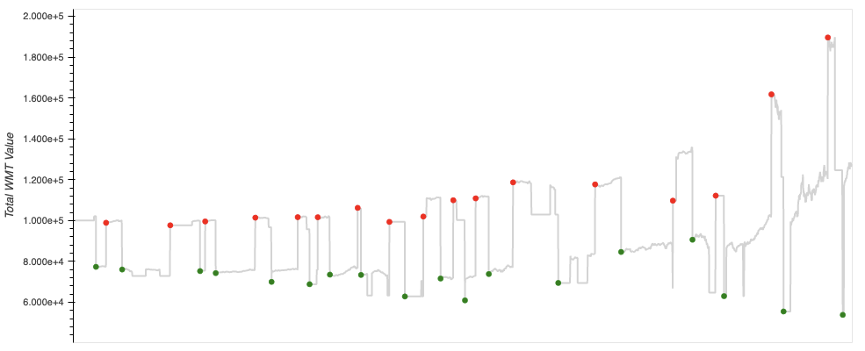
Strategy Vs. Backtest results

Slide 12
Evaluation Metrics
Discuss the techniques you used to evaluate the model performance.
Annual Return
Cumulative Returns
Annual Volatility
Sharpe Ratio
Sortino Ratio

Slide 13
Q&A
Any questions?

